Slide 1
An IMS based IPTV Network

Slide 2
Problem under Study
What is IPTV?
Reasoning behind the entrance into the TV market by telecommunications conglomerates?
Advantages of IPTV over Plain Old Cable system
Biggest hurdles that need to be overcome for IPTV to overtake incumbent system
Role of IMS in IPTV

Slide 3
Background/Existing products
Idea has been circulating since 1995, however has not caught onto public imagination due to several factors
Major Telcos all offer IPTV as part of 3play
Most widely used implementation is the CISCO Wireline Video/IPTV design. Generic architecture shown on following slide.

Slide 4
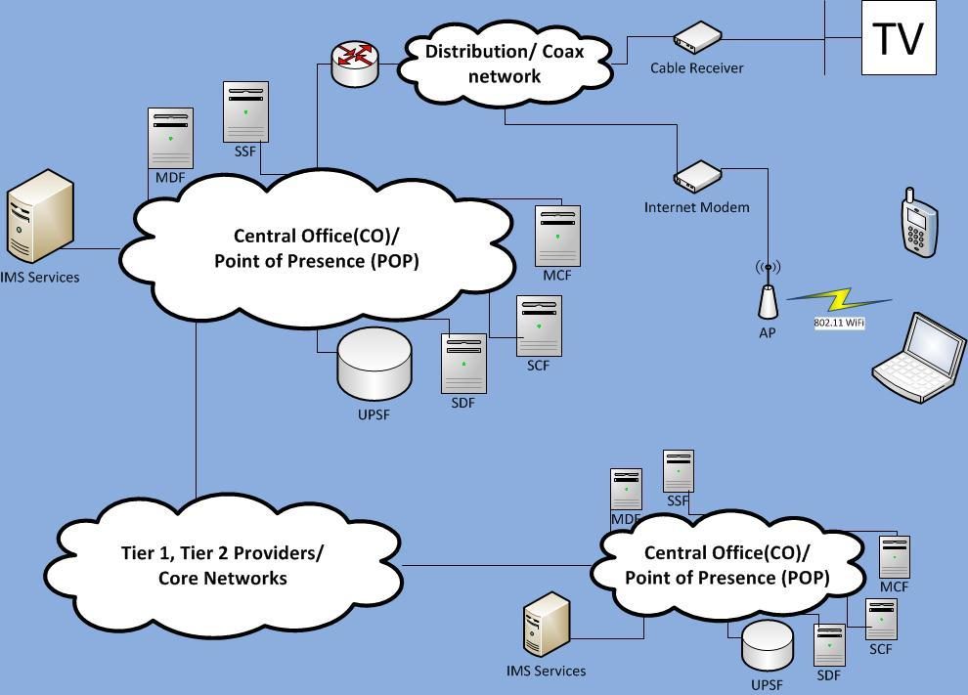

Slide 5
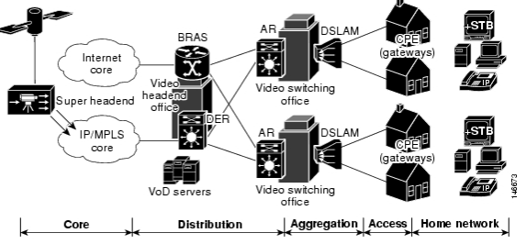
CISCO Solution – High level view

Slide 6
SWOT analysis
Strengths | Can possibly incorporate a great deal of added functionality. Video On-Demand, Live Streaming, Time -shifted Streaming. Service bundling can be initiated to provide more services for lesser cost to the user.
Weaknesses | Very dependent on bandwidth. Susceptible to high latency.
Opportunities | Telco becomes sole provider of a home’s communication and entertainment needs.
Threats | Incumbent cable broadcast systems have a monopoly over the TV market. There may be privacy issues involved with IPTV.

Slide 7
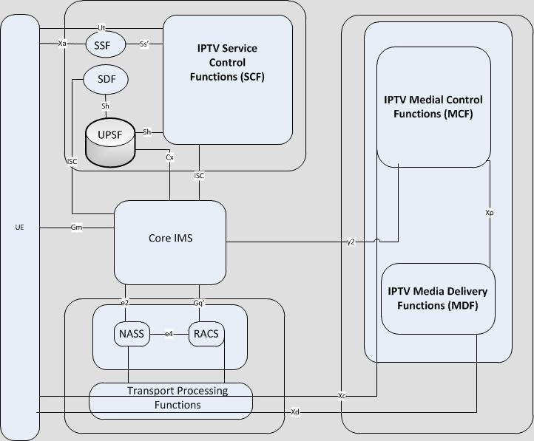
Describe in detail your design (text, diagrams, screenshots, etc). Use BPMN if possible.
Key
Ut= service profile config.
ES 282 007 [11]
Ss'= exchange service info. and/or Service Provider info.
Sh= ES 282 007 [11]
Cx= ES 282 007 [11]
ISC= ES 282 007 [11]
Gm= ES 282 007 [11]
e2= App. Function - NASS
ES 282 007 [11], ES 282 004 [3]
e4= ES 282 003 [8], ES 282 004 [3]
y2= Carry Service Control signalling from SCF to control MCF
Gq'= ES 282 007 [11],
ES 282 003 [8]
Xa= used by UE to make appropriate service selections
Xc=exchange media control messages for control of Media flow ES282 001 [1]
Xd = used to deliver media data ES 282 001 [1]
Xp = used to control media delivery sessions to support media delivery session setup
* IPTV Diagram from
ETSI TS 182-027

Slide 8
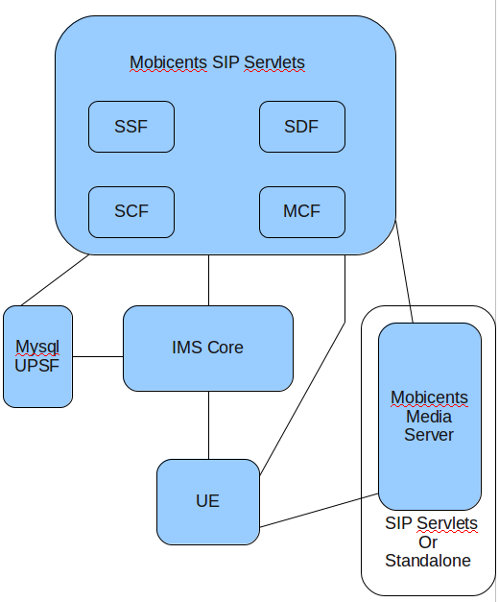
Design Plan

Slide 9
Design Description
Goals:
Create an IPTV service REQUIRED:
- user registration
- live-streaming channel selection
WANTING TO EXPLORE:
- adaptive stream quality depending on network conditions
- customized advertisement based on user profile
Service Components to be Created:
SDF
SSF
SCF
MCF
UE Client
Service Components Provided:
Mobicents Media Server (with JSR 309 API)
UPSF (using mysql database)
IMS Core (OpenIMS)

Slide 10
Tasks
1. Set up development environment with source control. (Yuri)
-need an environment where team mates can checkout/checkin and
test code from their home.
2. Document interfaces and functionality of our customized service
function and client software. (Group Effort)
3. Analyze and distribute development workload (Group Effort)
4. SDF Development. (Nikhil)
5. SCF Development. (Nishant)
6. SSF Development. (Nikhil)
7. MCF Development. (Yuri)
8. MDF Development (Yuri)
9. UE Client Development. (Group Effort)
10. Test the design and look for possible improvements in functionality (Group Effort)

